Slide 1
All about Linear Regression
Abu Bakar Siddique Mahi

Slide 2
Theory Part:
Straight Line
Curve Line
Slope
Intercept
Cost Function
Lose Function
Mean Absolute Error (MAE)
Mean Squared Error (MSE)
Gradient Decent
Coding with Python:
Implementing Linear Regression
Simple ML Project on Rent Prediction
Discussion on Assignment:
Weight Prediction Based on Height

Slide 3
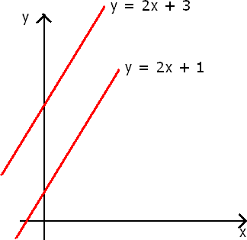
All about Linear Regression
X = 10, 30, 50
Y = 2*10 + 3 =23 Y = 2*30 + 3 = 63
Y = 2*50 + 3 = 103
Fig: Straight Line

Slide 4
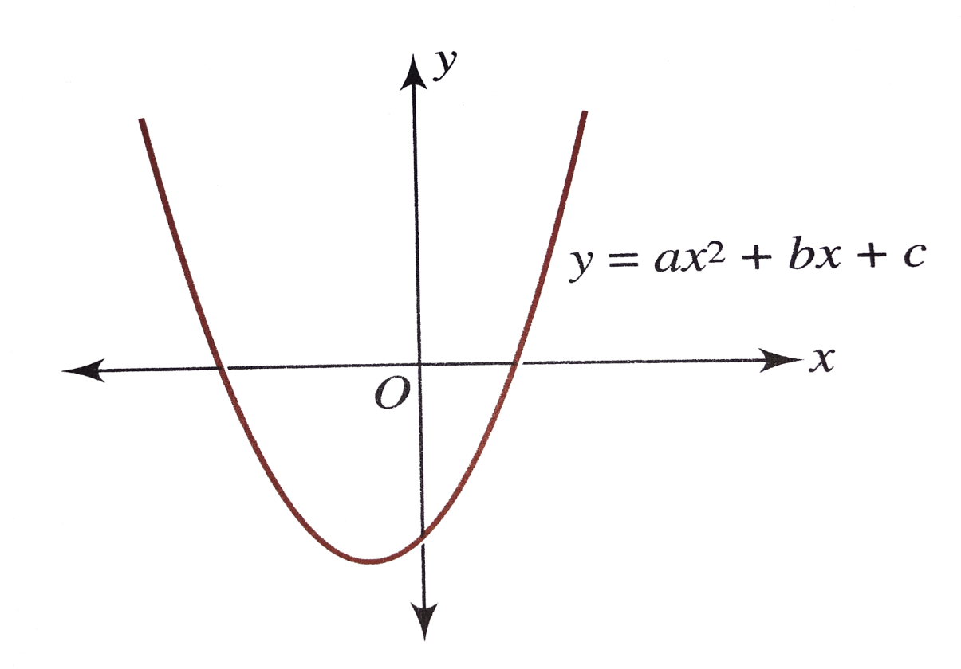
All about Linear Regression
Fig: Curve Line

Slide 5
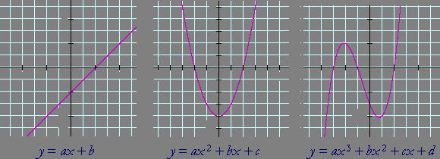
All about Linear Regression
Fig: Lines

Slide 6
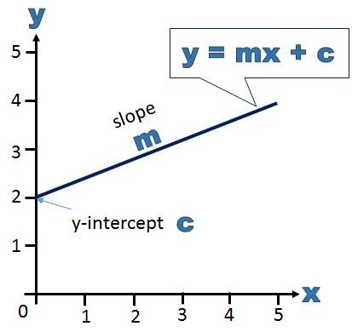
All about Linear Regression
Linear regression is a statistical model that allows to explain a dependent variable y based on variation in one or multiple independent variables (denoted x). It does this based on linear relationships between the independent and dependent variables.
y = mx + c

Slide 7
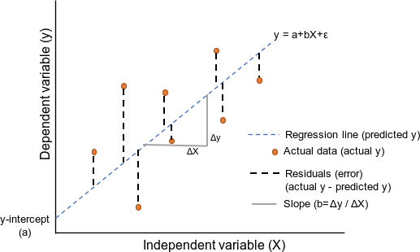
All about Linear Regression
Linear regression is a statistical model that allows to explain a dependent variable y based on variation in one or multiple independent variables (denoted x). It does this based on linear relationships between the independent and dependent variables.
y = ax + b / y = mx + c

Slide 8
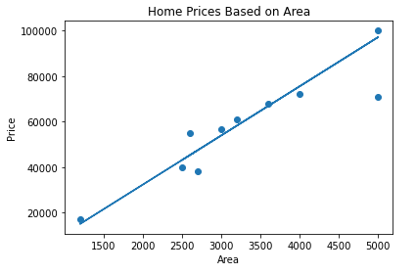

All about Linear Regression
y = mx + b ; or,
Y = 9.782* X + 1.48
Best Fit Line
1
Coefficient = 9.782
Intercept = 1.48

Slide 9
All about Linear Regression
y = mx + b ; or,
Y = 9.782* X + 1.48
Best Fit Line
1
Coefficient = 9.782
Intercept = 1.48

Slide 10
All about Linear Regression
y = mx + b ; or,
Y = 9.782* X + 1.48
Best Fit Line
1
Coefficient = 9.782
Intercept = 1.48

Slide 11
All about Linear Regression
y = mx + b ; or,
Y = 9.782* X + 1.48
Best Fit Line
1
Coefficient = 9.782
Intercept = 1.48

Slide 12
All about Linear Regression
y = mx + b ; or,
Y = 9.782* X + 1.48
Best Fit Line
1
Coefficient = 9.782
Intercept = 1.48

Slide 13
All about Linear Regression
y = mx + b ; or,
Y = 9.782* X + 1.48
Best Fit Line
1
Coefficient = 9.782
Intercept = 1.48

Slide 14
All about Linear Regression
y = mx + b ; or,
Y = 9.782* X + 1.48
Best Fit Line
1
Why this is
Best fit line?
Coefficient = 9.782
Intercept = 1.48

Slide 15
All about Linear Regression
y = mx + b ; or,
Y = 9.782* X + 1.48
Best Fit Line
1
How can we
draw it?
Coefficient = 9.782
Intercept = 1.48

Slide 16
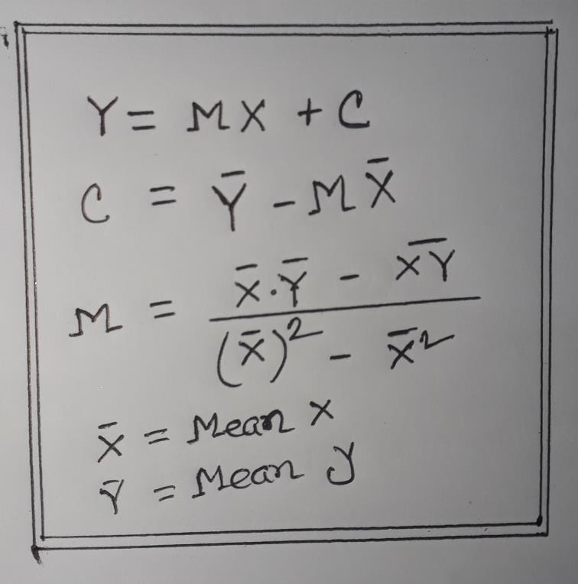
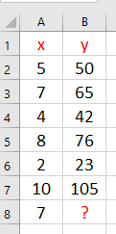
All about Linear Regression (Least Squares Method)
Formula of Linear Regression
Data Set
Now Solve it

Slide 17
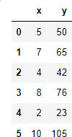
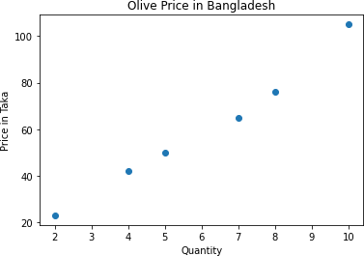
All about Linear Regression

Slide 18
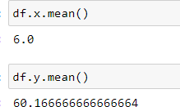
All about Linear Regression
Mean Values

Slide 19
All about Linear Regression
Mean Values

Slide 20
All about Linear Regression
Mean Values

Slide 21

All about Linear Regression
Formula of Linear Regression
Data Set
Now Solve it

Slide 22
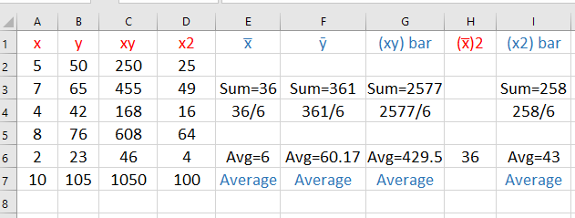
All about Linear Regression
Calculation Table for Single Variable Linear Regression

Slide 23
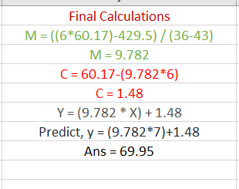
All about Linear Regression
Formula of Linear Regression

Slide 24
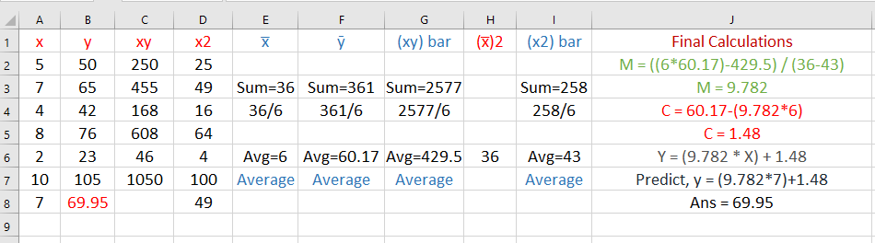
All about Linear Regression

Slide 25
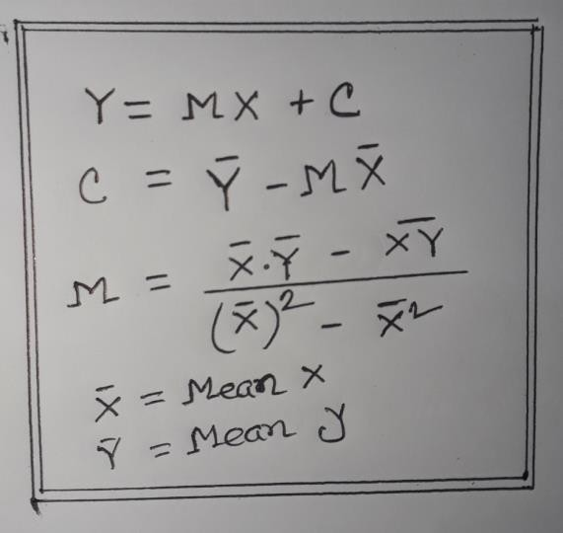
All about Linear Regression
Formula of Linear Regression

Slide 26
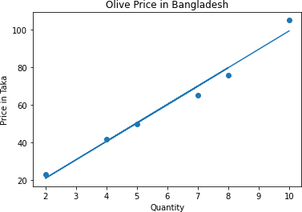
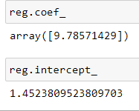
All about Linear Regression
Data Set
Value of M & C
Line

Slide 27
All about Linear Regression
Data Set
Value of M & C

Slide 28
All about Linear Regression
Data Set
Value of M & C

Slide 29
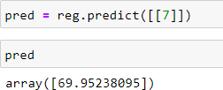
All about Linear Regression
Data Set
Predict New Value
Line

Slide 30
All about Linear Regression
Let’s Implement Linear Regression with Python

Slide 31
Linear Regression using
Gradient Descent

Slide 32
All about Linear Regression
Cost Function
The cost function is a function, which is associates a cost with a decision.
Map
Dhanmondi
Dhanmondi
Dhanmondi
Dhanmondi
Dhanmondi

Slide 33
All about Linear Regression
Cost Function
The cost function is a function, which is associates a cost with a decision
Map
50 min
55 min
30 min
40 min
20 min
Dhanmondi
Dhanmondi
Dhanmondi
Dhanmondi
Dhanmondi

Slide 34
All about Linear Regression
Cost Function
The cost function is a function, which is associates a cost with a decision
Map
Cost Function
50 min
55 min
30 min
40 min
20 min
Dhanmondi
Dhanmondi
Dhanmondi
Dhanmondi
Dhanmondi

Slide 35
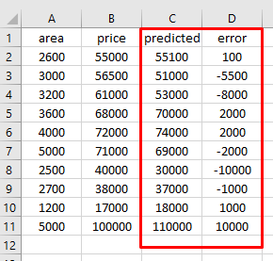

All about Linear Regression
Loss & Cost Function
A loss function is for a single training example. It is also sometimes called an error function. A cost function, on the other hand, is the average loss over the entire training dataset. The optimization strategies aim at minimizing the cost function
Predicted Price (Y) = m * area + c
L1 Loss (error) = ( 1/n ) *| (yi – y^) | Yi = Area for each row
Y^ = Predicted Value

Slide 36
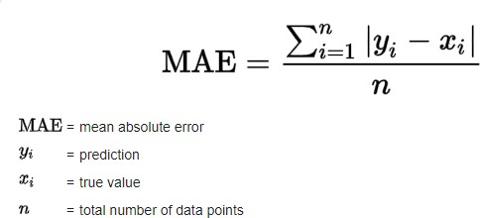
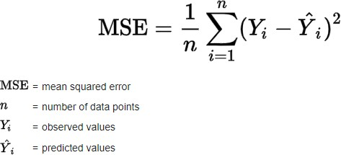
All about Linear Regression
Cost Function
The cost function is a function, which is associates a cost with a decision. It indicates the difference between the predicted and the actual values for a given dataset. An ideal value of the cost function is zero. In regression, the typical cost function (CF) used is the mean squared error (MSE) cost function. The form of the function is shown below.

Slide 37
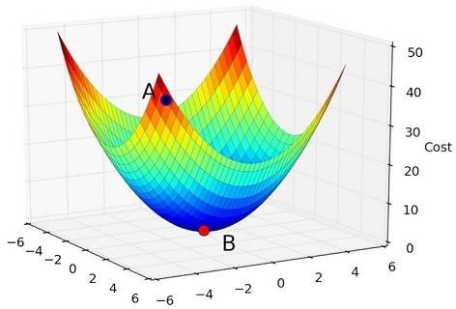
All about Linear Regression
Minimizing the cost function: Optimizer Gradient Descent
MSE (COST)

Slide 38
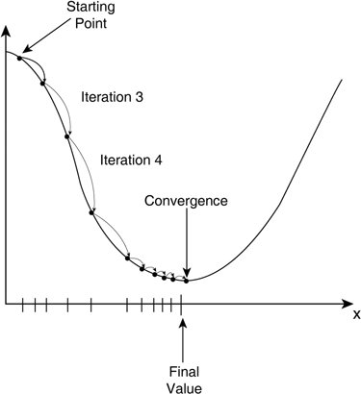
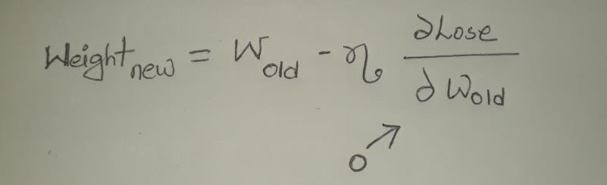
All about Linear Regression
Minimizing the cost function: Optimizer Gradient Descent
m=c=0
Gradient descent is an efficient optimization algorithm that attempts to find a local or global minima of a function. At this point the model has optimized the weights such that they minimize the cost function. Gradient descent enables a model to learn the gradient or direction that the model should take in order to reduce errors
MSE (Cost)
Global Minima
Weight (W)

Slide 39
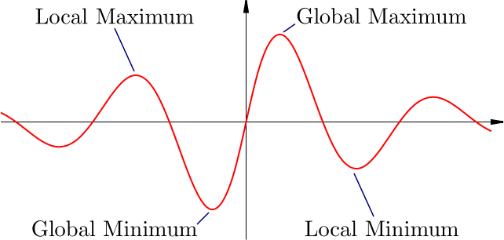
All about Linear Regression
Minimizing the cost function: Gradient Descent

Slide 40
All about Linear Regression
Let’s Implement Linear Regression with Python

